Slide 1

Cloud Based Inventory Management System
By Aaryan Maheshwari (22BDO10001)
Chayan Gope (22BDO10036)

Slide 2
Introduction to Inventory Management
In this presentation, we will explore optimal inventory management with our cloud-based system.
We will discuss features, benefits, and what the preliminary findings of its usage were in terms of reaching efficiency of operations and cost decline.
Problem Statement:-
Businesses face difficulty tracking inventory accurately due to delays, errors, and lack of integration between systems.
A cost-effective, scalable, and user-friendly inventory solution is needed.

Slide 3
Objectives of our project
Primary Objective:
To design and develop a cloud-based inventory management system that will ensure monitoring in real time, reduces mistakes, and increases efficiency.
Secondary Objective:
Provide a scalable solution that is suitable for businesses of all sizes.
Seamless integration with existing ERP and CRM systems.
Provide analytics and reporting for better decision-making.

Slide 4

Key Features
Our cloud-based inventory management system has a set of various key features such as real-time tracking, automated reordering, and reporting. The functionalities ensure that businesses maintain optimum levels of stock while minimizing excess and stockouts.

Slide 5
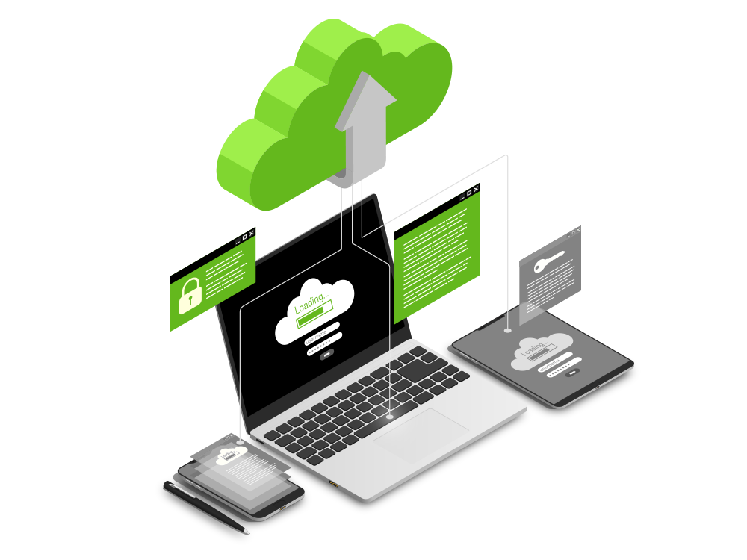
Methodology
System Requirements Gathering:
Conduct surveys and interviews with businesses to identify key pain points.
Design Phase:
Develop a user-friendly interface and database structure.
Select suitable cloud platforms (e.g., AWS, Azure, Google Cloud).
Development:
Implement core features such as inventory tracking, barcode scanning, and alerts for low stock levels.

Slide 6
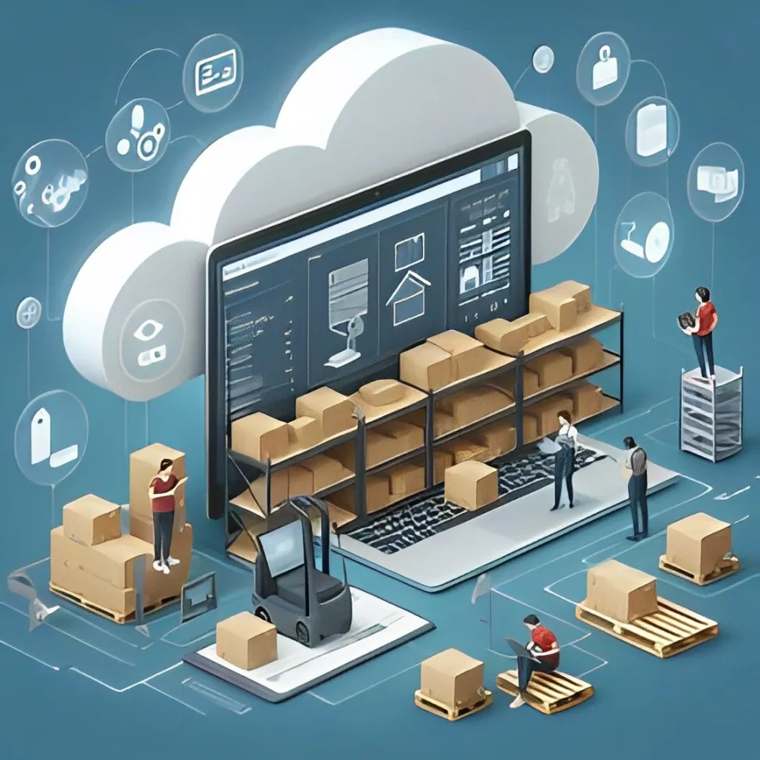
Methodology
Integration:
Integrate with third-party systems (e.g., POS, ERP, and accounting software).
Testing & Validation:
Perform rigorous testing to ensure functionality, scalability, and security.
Deployment & Training:
Deploy the solution on the cloud and provide training to users.

Slide 7

Experimental Setup Design
Tools & Technologies:
Cloud Provider: AWS
Database: MongoDB Atlas
Backend: Node.js, Python
Frontend: ReactJS,
Security: OAuth 2.0, JWT Authentication, SSL Encryption
Testing Environment:
Use a cloud VM instance to deploy the backend.
Run simulated inventory transactions to test system performance.
Implement load testing (JMeter, Locust) for handling multiple requests.

Slide 8
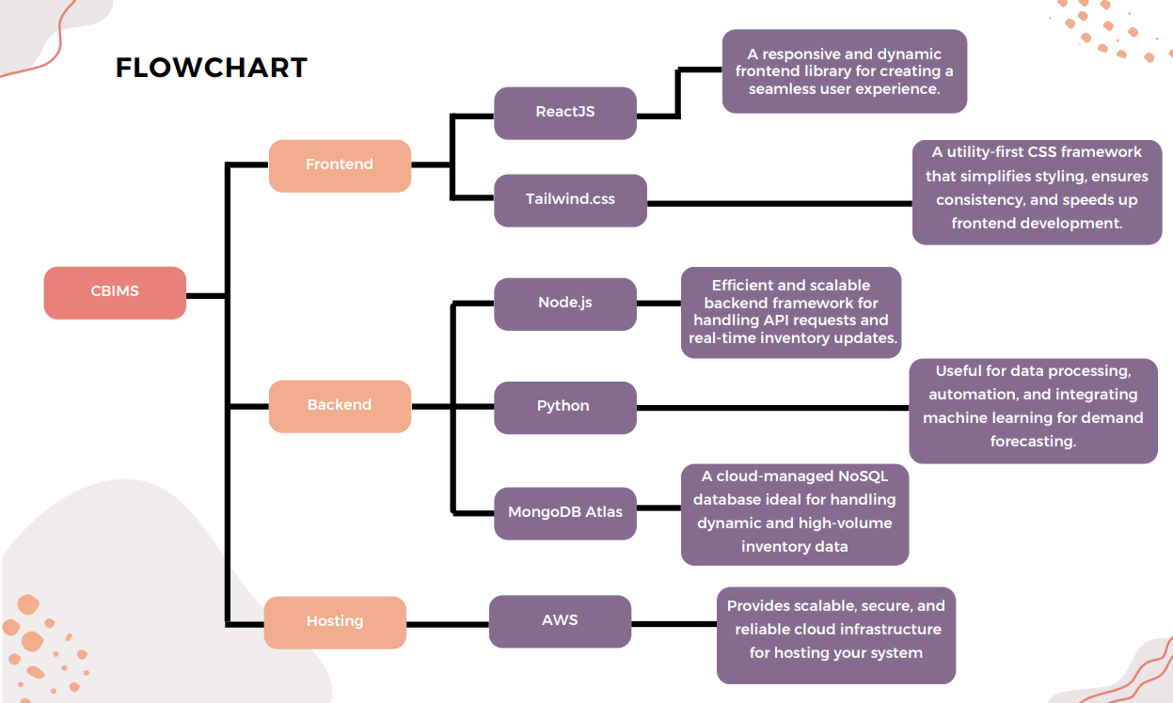

Slide 9

Benefits of Cloud-Based Solutions
The cloud-based solution provides businesses with scalability, flexibility, and cost-effectiveness. Businesses can access their inventory data from anywhere, enabling better decision-making and collaboration among teams, ultimately leading to enhanced productivity.

Slide 10
Any Questions or Feedback?

Slide 11
Thank you

